Slide 1



Home
Sweet -Smart-
Home
“A modern approach to smarter living”
Internet of Things(IOT) training - summer 2025

Slide 2

Meet Our Team Members
Nada Fayez
Mariam Ramadan
Nouran Hassan
Aya Youssef
Shahd Nezar
Omnia Mohamed
Team Leader, MQTT Integration
Web App Frontend
Web App Backend, Wokwi Simulation
Supabase Integration, REST API
ESP32 Hardware, Executed Code

Slide 3
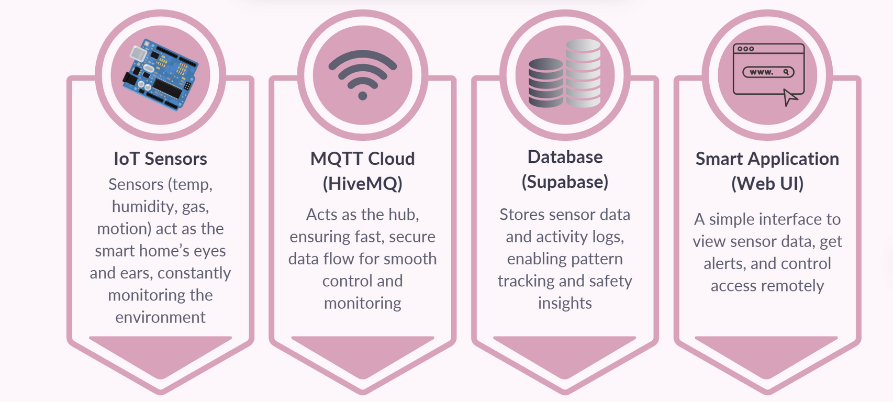
Project Overview
Our project is a Smart Home System designed to make homes safer, smarter, and more comfortable through seamless IoT integration

Slide 4
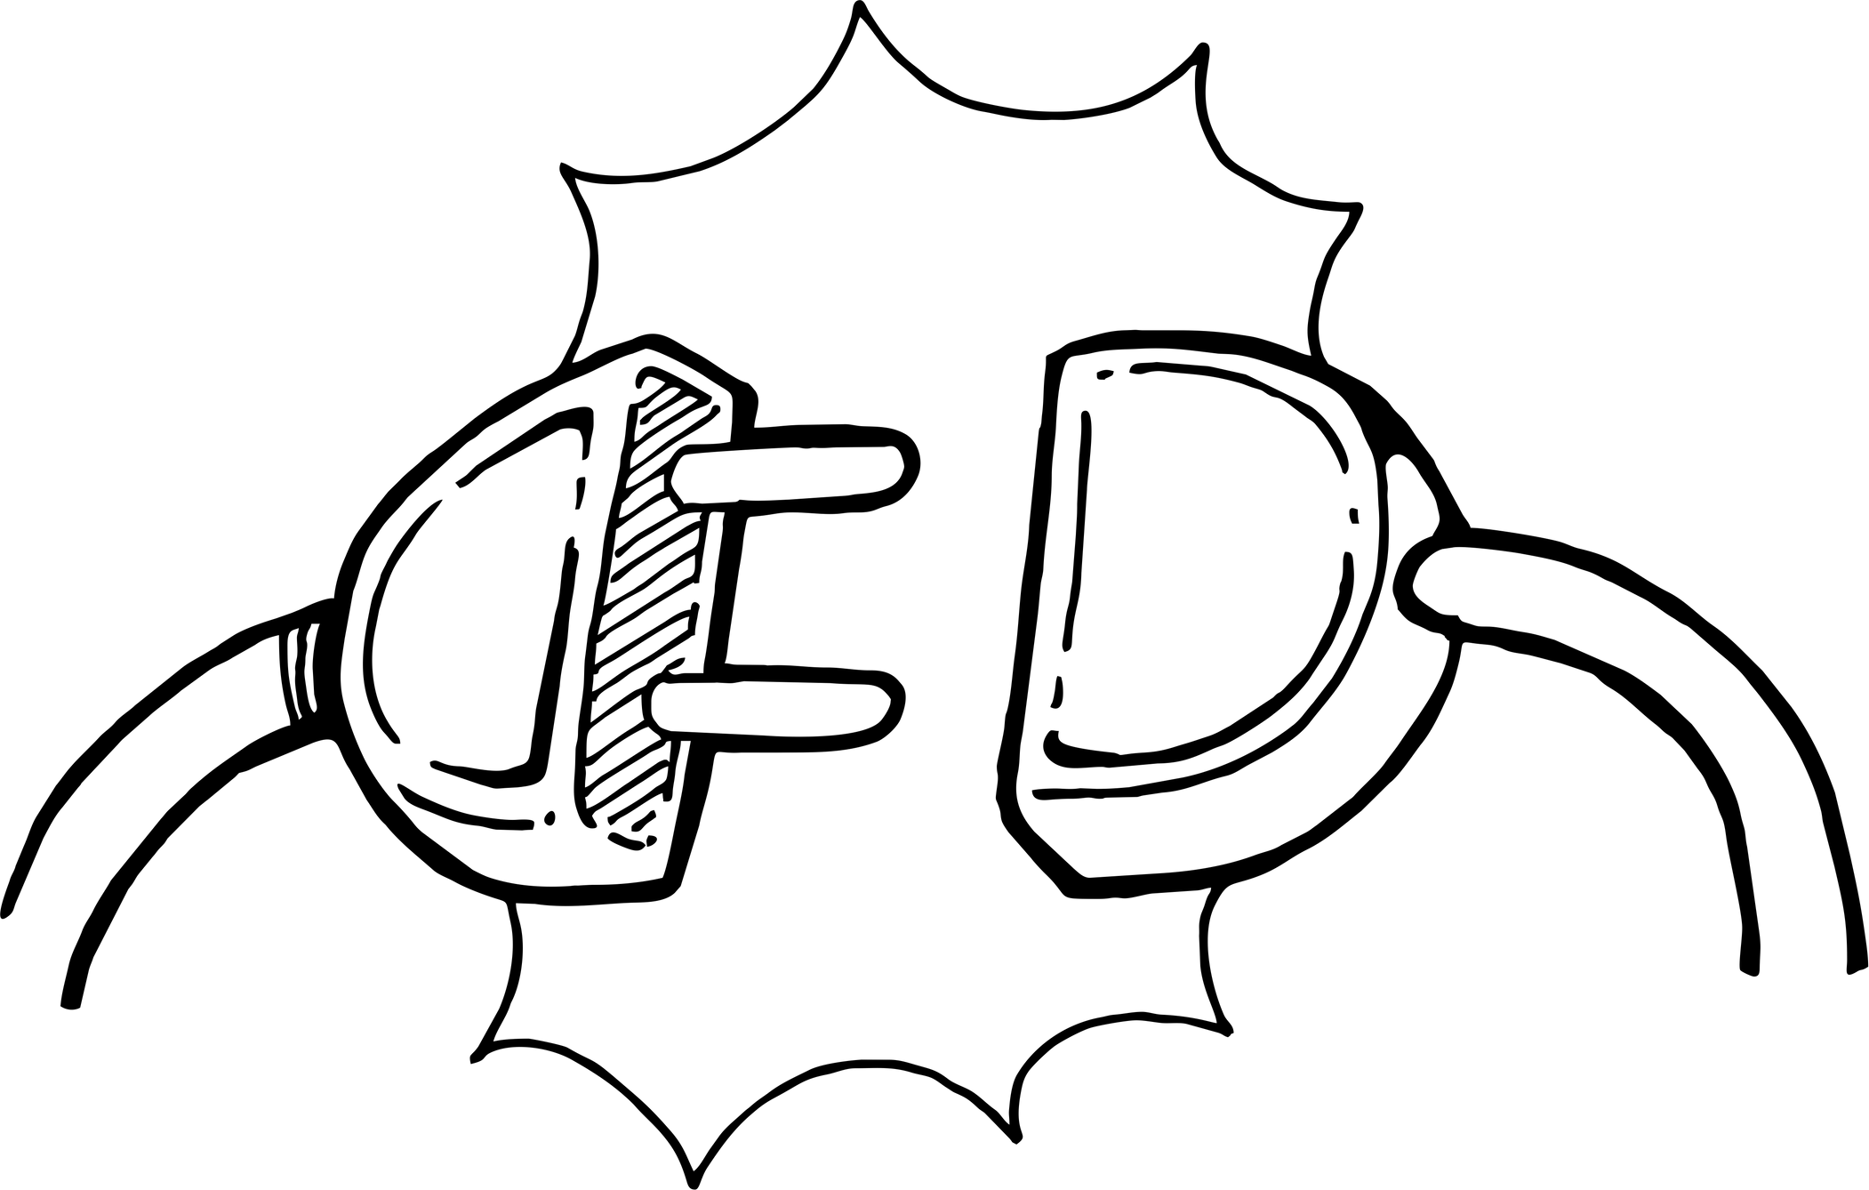
IOT hardware
The hardware side represents the core of a smart home system.
Various sensors collect environmental data such as temperature, humidity, motion, and gas
Output modules such as LEDs, buzzers, and servo motors enable direct responses such as alerts or control
The ESP32 acts as the central component connecting these components. It receives inputs from the sensors, processes them, and then sends commands to connected devices. The results are displayed on an LCD screen or sent to an app

Slide 5
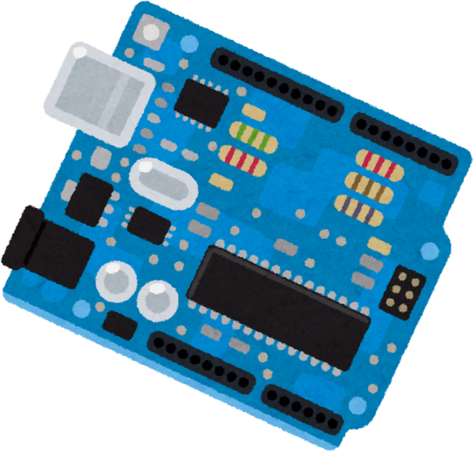
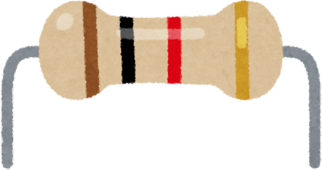

The components:
ESP32
It's the brain of the project, reading data from various sensors (temperature, humidity,
gas, motion, current, light).
It controls actuators (LEDs, servo, buzzer, LCD)
It has built-in Wi-Fi and Bluetooth, so it can communicate with the MQTT Cloud or the app
Breadboard + Jumper Wires + Resistors
Breadboard: Allows components to be assembled without soldering, making it easy to change and modify.
Jumper wires: Connect the components to the ESP32.
Resistors: A protection element used with LEDs to prevent excessive current from passing through and damaging them. They also work with LDRs to create a voltage divider so we can read the lighting value

Slide 6

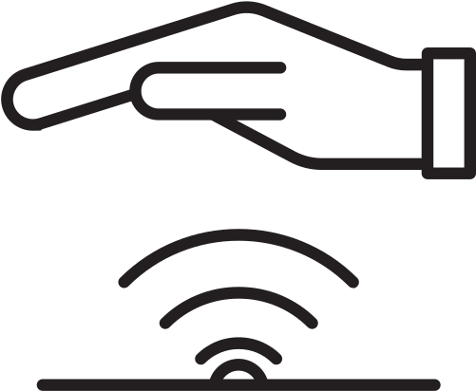
Sensors
DHT11 (Temperature & Humidity) → GPIO 4
Measures temperature and humidity with reasonable accuracy.
If the humidity or temperature exceeds normal limits, an alert is issued.
Important for occupant comfort, it also provides an alarm if the temperature is too high (fire hazard)
PIR Motion Sensor → GPIO 15
Detects movement (human) via infrared light.
If motion is detected:
Triggers a buzzer as an alarm.
Turns on a yellow LED for a visual alert.
Sends a log to the app/database (movement detected)

Slide 7


Gas Sensor (MQ-x) → GPIO 34 (Analog)
Flammable gas sensor (such as natural gas).
Outputs an analog signal based on the gas concentration.
When the concentration reaches the danger level:
turns on the red LED and turns on the buzzer.
Sends a warning message to the application (!!! GAS ALERT!!!)
Current Sensor (ACS712) → GPIO 35 (Analog)
Measures the electrical current consumed.
If there is an overcurrent (high electrical draw), the blue LED turns on.
(!!!The LCD displays (CURRENT ALERT

Slide 8

LDR (Light Dependent Resistor) → GPIO 32 (Analog)
A sensor that measures light intensity.
It connects to a resistor to create a voltage divider so we can read the signal.
Its function in the project:
If the light is weak, it automatically turns on the Garden LED
Actuators
Servo Motor → GPIO 13
Controls the opening/closing of a virtual door via the application
Receives commands from the application and is affected by the motion sensor
Moves at a precise angle using a PWM signal

Slide 9
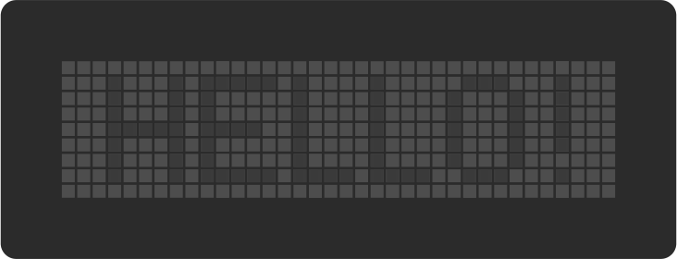
Buzzer → GPIO 2
Audible alarm trigger.
Operates in the following cases: Gas Alert, Motion Detection
LCD (16x2 with I2C) → SDA 21 / SCL 22
A small screen displays real-time data.
It switches between three displays:
Temperature + Humidity, Gas + Power Consumption, Light + LED Status
It displays alerts such as: GAS ALERT, CURRENT ALERT

Slide 10
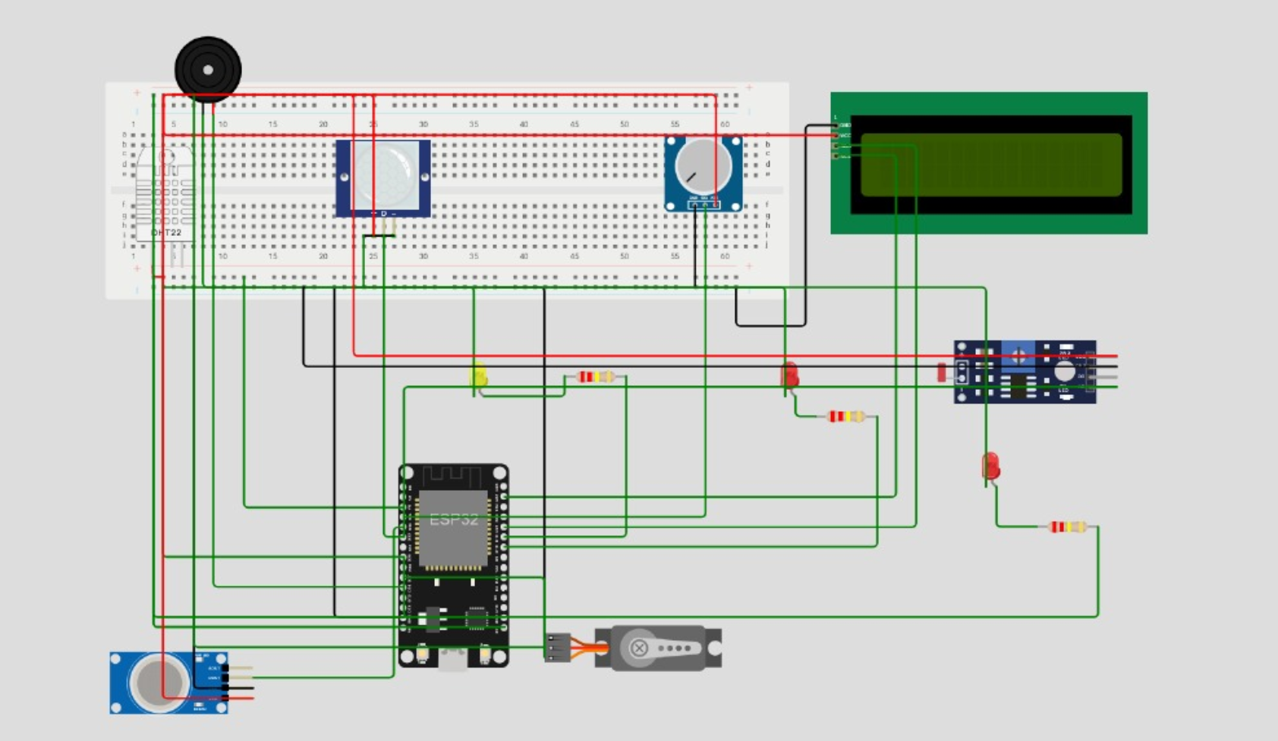
Wokwi Simulation

Slide 11
MQTT Cloud (HiveMQ)
The MQTT protocol is a lightweight protocol specifically designed for Internet of Things (IoT) systems to efficiently transfer data between devices. In our project, we used HiveMQ Cloud as the primary broker to manage communication between sensors (via ESP32), the application, and the
database
How it works:
The ESP32 reads sensor data and publishes it to specific topics within HiveMQ
Any client, such as an application or database, subscribes to these topics to receive the data immediately
This creates real-time connectivity, ensuring that any changes in the system are immediately visible to the user

Slide 12
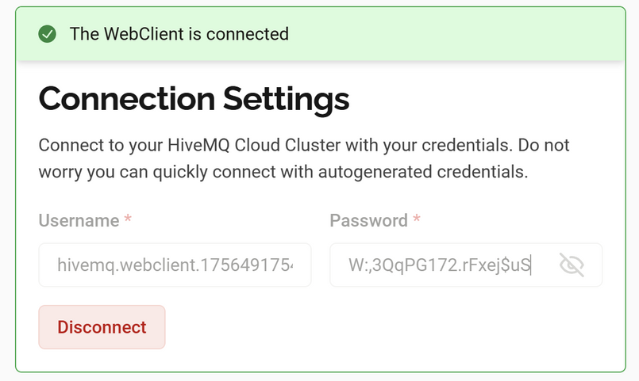
MQTT Cluster
The MQTT Cluster in HiveMQ is the heart of the communication
system.
It is a broker server that receives messages from any device
(publisher) and delivers them to the devices or applications
that are interested in them (subscribers).
Advantages of a cluster:
Flexibility: Devices can be easily added or removed without affecting the rest of the system.
Security: All communication is handled over TLS/SSL with a username and password to protect data.
Scalability: It can handle thousands of messages per second without delay.
Reliability: Using different QoS levels, we ensure that important messages are delivered no matter what

Slide 13
Topics & Message Flow
esp32/sensors/data
Description: Holds sensor data (Temperature, Humidity, Gas, Current, Motion)
User: The ESP32 performs Publish, while the application and database perform Subscribe
Importance: QoS 0 (because the data is constantly being updated)
esp32/door/control
Description: Door open/close commands
User: The application runs Publish, and the ESP32 runs Subscribe and executes
Importance: QoS 2 (Critical – must be executed exactly once)
esp32/door/status
Description: Shows the door status (opened/closed)
User: The ESP32 is running Publish, and the application is running Subscribe
Importance: QoS 1 to ensure update delivery

Slide 14
esp32/light/control
Description: Light on/off commands
User: The application is running Publish, and the ESP32 is running Subscribe
Importance: QoS 2
esp32/light/status
Description: Displays the light's (on/off) status
User: The ESP32 is running Publish, and the application is running Subscribe
Importance: QoS 1
esp32/alerts
Description: Alerts such as (gas leak, high temp, motion detected)
User: The ESP32 is running Publish, and the application is running Subscribe, displaying them immediately
Importance: QoS 1

Slide 15
esp32/history
Description: Records all historical events and system activities
User: The ESP32 is running Publish, and the MQTT Worker is running Subscribe
Importance: QoS 1

Slide 16
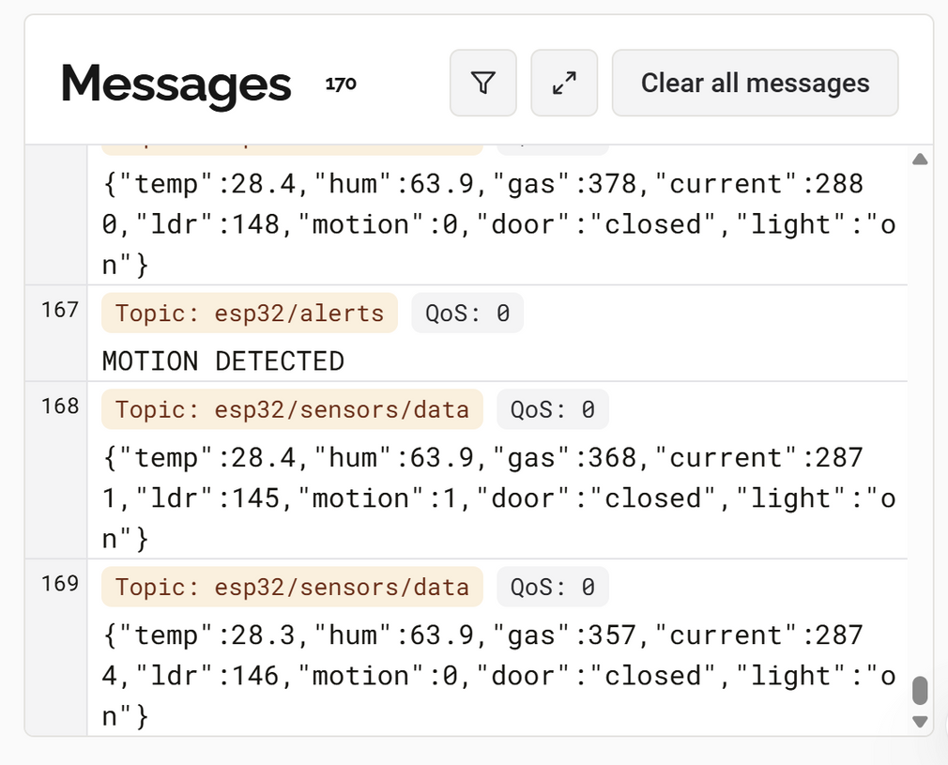
All communication between devices (ESP32,
application, server) is done through short, lightweight
messages.
A message consists of:
Topic → the address the message is sent to
Quality of Service (QoS) → the level of assurance of
delivery.
Payload → the content (usually JSON containing
sensor data or control commands).
Messages are tracked via Publish from one device
and delivered to any other device that subscribes to the same topic.
The main advantage: lightness, speed, and reliability, even on weak networks

Slide 17
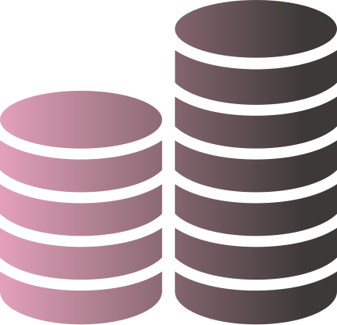
Database (Supabase)
In our project, the database represents the backbone of the system. It acts as the central repository where all information generated by the sensors, users, and applications is securely stored and organized
We relied on Supabase, a cloud-based PostgreSQL platform, which provided both reliability and flexibility. This allowed us to design structured tables, maintain relationships between them, and offer a real-time API that integrates smoothly with the other components of the system
By using this database, the smart home solution is not only able to log events and readings, but also to track patterns over time, generate useful insights, and ensure that data remains accessible and consistent for all parts of the project

Slide 18
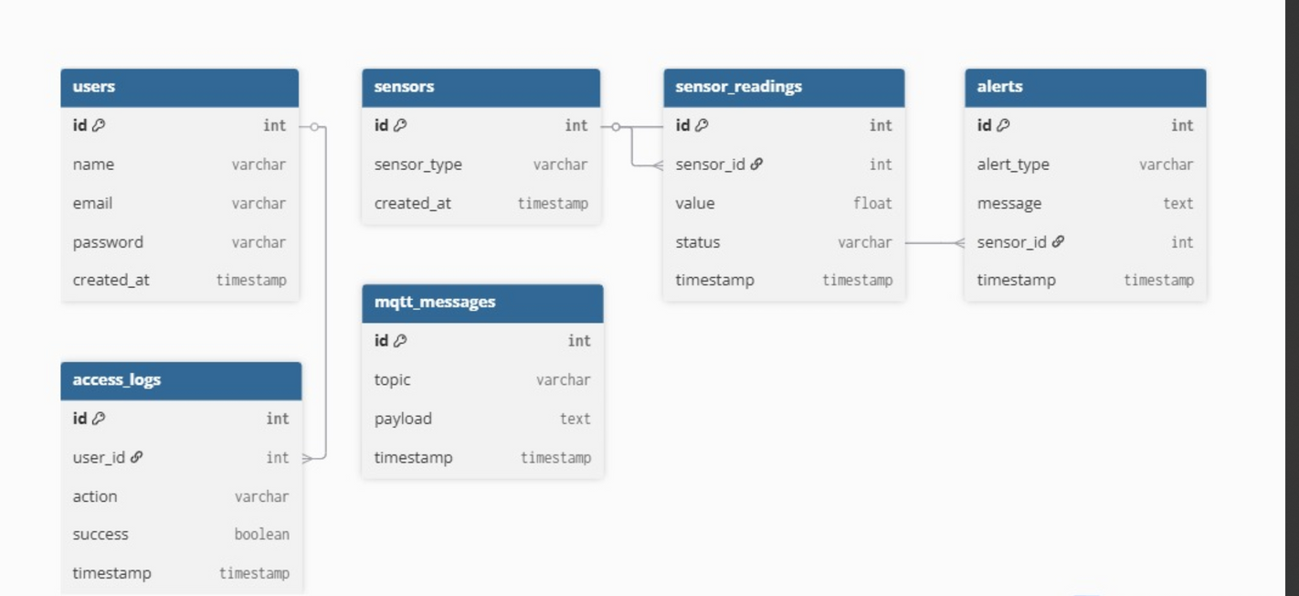
The database schema was designed to ensure that all system
data is stored in a structured and relational manner.
- The Users table holds information about
system users.
- The Sensors table defines each sensor in the
smart home,while the Sensor Readings table
stores their real-time values.
- The Alerts table captures critical events such as
gas leaks or unusual motion.
- The Access Logs table records all entry attempts, whether successful or failed.
- Finally, the MQTT Messages table logs the communication
between devices and the cloud.

Slide 19
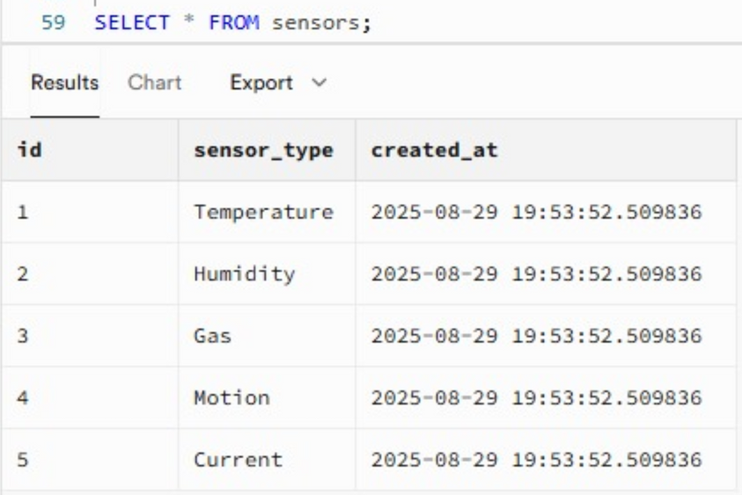
To verify our schema, we queried the sensors table:
Shows all registered sensors in the system.
Each row includes ID, type, location, and creation time.
Confirms that devices (temperature, humidity, gas, motion, current, ) are successfully stored in the database.

Slide 20
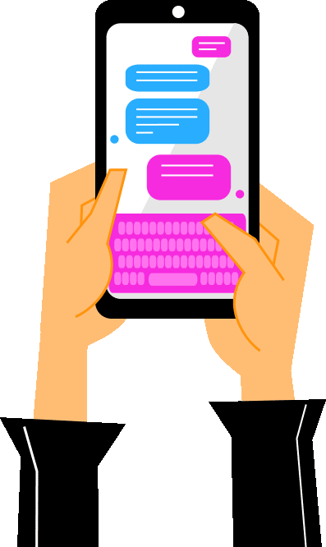
Web Application
This application serves as the central platform for a smart home system, combining Internet of Things (IoT) and artificial intelligence technologies within a single interface. It allows users to easily monitor sensors and control security systems and smart devices, while ensuring speed and reliability
The system is built using an interactive web interface developed in React.js and HTML5, with a backend based on Python Flask and RESTful APIs. It relies on a Supabase (PostgreSQL) database for data management and supports instant connection to IoT devices via MQTT. It also features a real-time alert system and a virtual assistant (chatbot) for user interactio
The application is designed to be flexible and scalable, supporting a wide range of devices and systems. It offers a unified dashboard, a real-time notification system, data reports and analysis, and remote control capabilities, ensuring an integrated experience that combines ease of use and efficiency

Slide 21
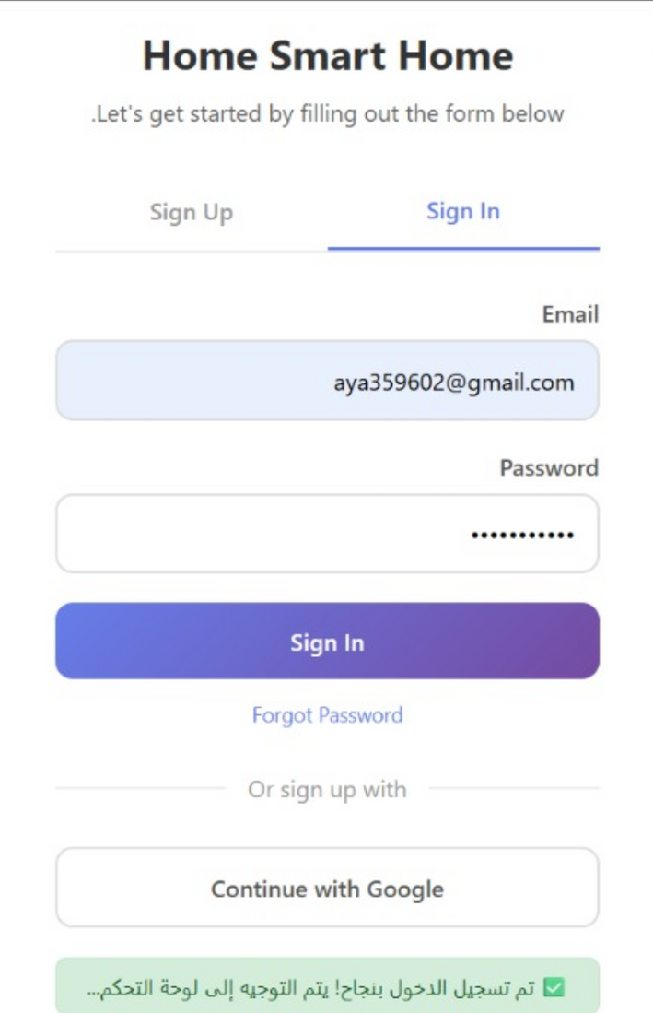
Login and Registration Page
HTML: The page contains two main tabs
(Sign in / Create an Account), each tab displaying a custom form.
The login form includes email and password fields, a password
recovery option, and a Sign Up with Google button.
The account creation form provides name, email, password,
and confirmation fields.
JavaScript: The code controls the tabs to switch between forms
It sends login data to the server for verification, saves the session
token, and redirects the user to the control panel if successful. It
also handles account creation by verifying that passwords match
sending and saving the data, displaying interactive messages to
the user, and confirming an active session when the page loads

Slide 22
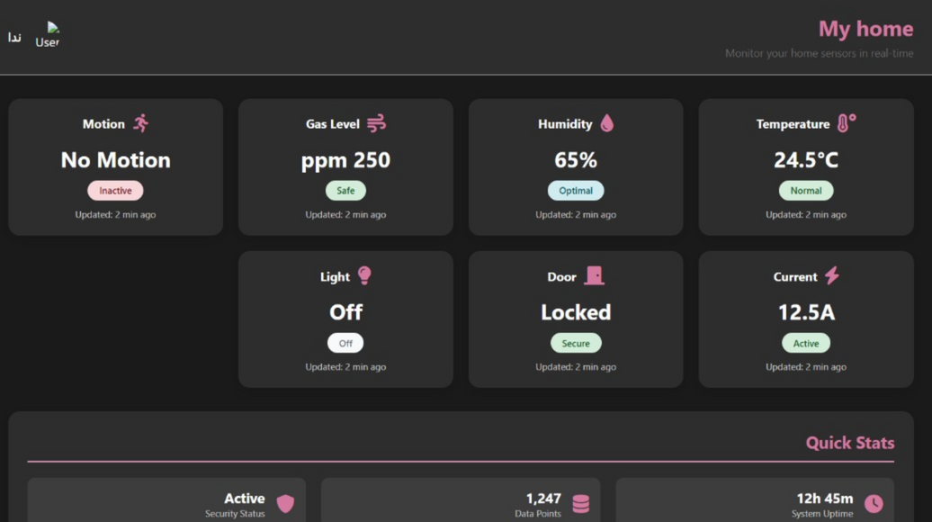
Dashboard Page
HTML → The page is divided into two main parts:
A sidebar containing a welcome page, links for navigating between pages (My Home, Control, Alerts, History, Settings), an alert counter, a button to toggle Dark Mode, and a logout button.
The main content displays the sensor panel in the form of cards (Temperature, Humidity, Gas, Motion, Current, Door, Lighting), with quick statistics such as uptime, data count, and security status.
JavaScript → The code is responsible for:
Managing page navigation and updating active elements.
Controlling light/dark mode and storing preferences locally.
Implementing logout by clearing session data.
Fetching sensor data from the API every 5 seconds and updating cards in real time (values, status, refresh time).
Checking for a session token upon page load and redirecting the user to the login page if they are not logged in

Slide 23
Control Page
HTML:
Sidebar: Navigation between pages (Home, Control, Alerts, History) + Notifications + Theme Selection (Light/Dark) + Logout and Return to Dashboard Buttons.
Main Content:
Door control card (open/lock + display current status).
Light control card (master switch + separate room switches).
Quick Actions section: Quick commands such as Home, All Off, and Security.
JavaScript:
Manage page navigation and theme activation.
Verify tokens and manage logout.
Door and lighting control (on/off + status update via API).
Execute quick commands such as turning off all devices or activating security mode.
Retrieve device status from the server and automatically update the interface.
Display pop-up notifications upon success or failure of commands

Slide 24
Notifications Page
HTML:
Sidebar: Navigation between pages (Home, Control, Alerts, History) + Notification count + Theme toggle (Light/Dark) + Logout and Back to Dashboard buttons.
Main Content:
Tabs for New and All notifications.
Each notification shows: title, message, time, type icon, and action buttons (Mark as Read / Delete).
Stats section: Total notifications, Unread, Read, Important.
JavaScript:
Manage page navigation and active tab switching.
Toggle Dark/Light mode and save preference.
Fetch notifications from API or display sample data.
Mark individual or all notifications as read.
Delete notifications individually or all at once.
Update stats and badges dynamically.
Show pop-up messages on success or error for actions.

Slide 25
Alerts Page
HTML:
Sidebar: Links (Home, Control, Alerts, History), alerts count, dark mode toggle, logout/back buttons.
Main: Filters (Type & Status), alerts list (type, message, time, actions), stats (Critical, Warning, Info, Resolved).
JavaScript:
Handle navigation & dark mode.
Check login token.
Fetch & filter alerts.
Resolve/Ignore alerts.
Update stats & show notifications.

Slide 26
History Page
HTML:
Sidebar: Links (Home, Device Control, Alerts, History), notifications count, dark mode toggle, logout/back buttons.
Main: Filters (Type & Date Range, Custom Range toggle), history stats (Total Events, Door Accesses, Alerts, Light Controls), history list (event type, message, timestamp), pagination, export button.
JavaScript:
Handle navigation & dark mode toggle.
Check login token on load.
Fetch history data from API or display sample data.
Display history with pagination.
Apply & clear filters (Type & Date Range).
Export history to CSV (placeholder).
Show notifications.
Update stats dynamically.

Slide 27
Dockerization
Docker is a tool that lets applications run in containers. This means that each application has all the files and libraries it needs to run independently. This keeps the development environment identical to the production environment, eliminating version and configuration issues
In the Smart Home IoT project, we have multiple services (ESP32 Server, Flask API, Web UI, Supabase). Docker allows each service to run in a separate container with its own port, without affecting the others. We can also run the entire project with a single docker-compose command
Isolation: Each service runs independently, avoiding conflict
Portability: The project can be easily moved to any device or server
Reproducibility: Anyone running the project will see the same results without any configuration issues

Slide 28
Docker Images – Building Blocks
Each service in the Smart Home IoT project has a Docker image ready.
esp32-server and mock-api already have images ready.
We built flaskapi and web-ui from a custom Docker file for each.
After the images were ready, we ran each service as a separate container on the local machine.
We used docker-compose to connect all the containers together and distribute the ports so that everything runs seamlessly

Slide 29
Follow this link to enjoy the github repo:
https://github.com/NadaFayez13/Smart_Home_IOT

